Slide 1
Enhancing Financial Distress Prediction with Preprocessing and Ensemble Methods:
A comparative study
Mithul Murugaadev
Student ID: 1130073

Slide 2
AGENDA
Introduction
Literature Review
Research Methodology
Analysis (Exploratory Data Analysis)
Results and Discussion
Conclusion
References (Literature review)
i

Slide 3
Introduction – Financial distress
Financial distress is a situation of an organization’s inability to meet its financial obligations
Financial distress prediction is vital for stakeholders to prevent adverse outcomes such as bankruptcy and financial crises.
Advanced Machine learning algorithms are found to be very suitable to identify complex patterns within financial data
However, the predictive power of models is often compromised by challenges like missing data and class imbalances in financial datasets.
1

Slide 4
Introduction – Thesis questions
Research questions this thesis addresses:
What are the most effective techniques for imputing missing values?
What are the most suitable class imbalance handling methods for preprocessing financial data?
How do various ensemble tree methods and other advanced modeling techniques compare in terms of performance?
2

Slide 5
Literature review – Machine learning introduction
Machine learning algorithms are used in finance under domains such as Cryptocurrency, Forex, Portfolio management, etc.
Traditional models like logistic regression and discriminant analysis have been widely used but struggle with large, complex patterns.
Recent advances incorporate machine learning techniques integrated with text and network data (Matin et al., 2019; Huang et al., 2024; Kadkhoda and Amiri, 2024).
Advanced models such as automated financial distress prediction are also a key area being explored (Balachander et al., 2023; Papík and Papíková, 2024).
3

Slide 6
Literature review – Data quality and challenges
Advanced techniques are used for class imbalance and missing value imputation, such as SMOTE, ADASYN for imbalance handling methods, Kmeans and Mean imputation methods.
However, existing literature often fails to adequately address the interaction between data imputation and class imbalance handling in financial distress prediction.
Additionally, studies have placed less emphasis on preserving the originality of the data.
This thesis fills these gaps by systematically integrating and evaluating advanced preprocessing techniques within predictive models, providing new insights into their effectiveness.
4

Slide 7
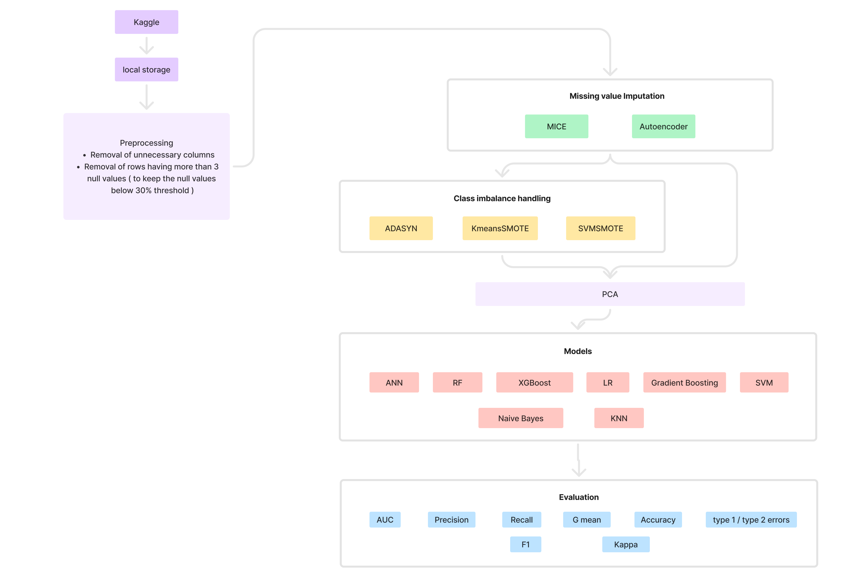
Research methodology
8 datasets (2 imputed datasets, 6 combined datasets)
Evaluation metrics to capture the effect of imbalance of data.
5

Slide 8
Research methodology
Exploratory analysis and visualizations
t-SNE preserves and helps in visualizing local structures and relationships between data points
PaCMAP - Maintains both global and local structures in the data
Imputation methods
MICE and Autoencoders to capture values of interrelated columns
Class imbalance methods
ADASYN is effective at capturing overlapping classes.
KMeans SMOTE (KMSMOTE) helps generate synthetic samples that are more evenly distributed across the feature space.
SVMSMOTE aids in achieving distinct separation of classes.
6

Slide 9
Research methodology
Evaluation techniques
G-Mean – Balances sensitivity and specificity.
F1 score – Balances precision and recall.
Kappa – Measures prediction agreement beyond chance.
Type 1 and type 2 error rate – measures the performance of models classifying both classes
7

Slide 10
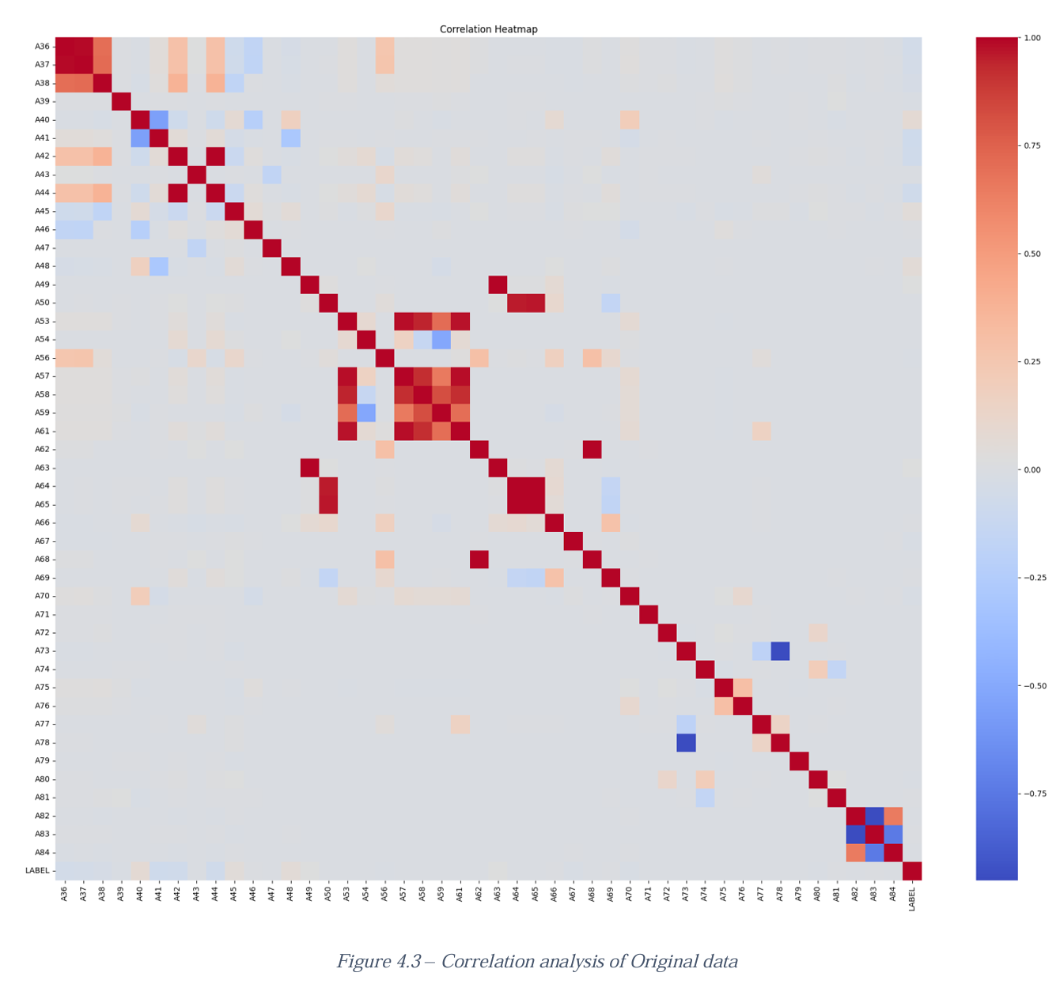
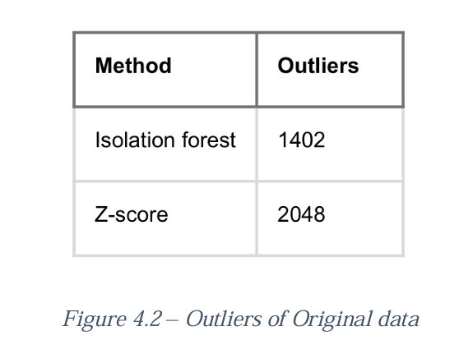
Analysis
Pearson and Spearman indicates non-linearity in the dataset.
Correlation analysis reveals highly correlated variables.
Skewed data results in a high number of outliers in the tails
8

Slide 11
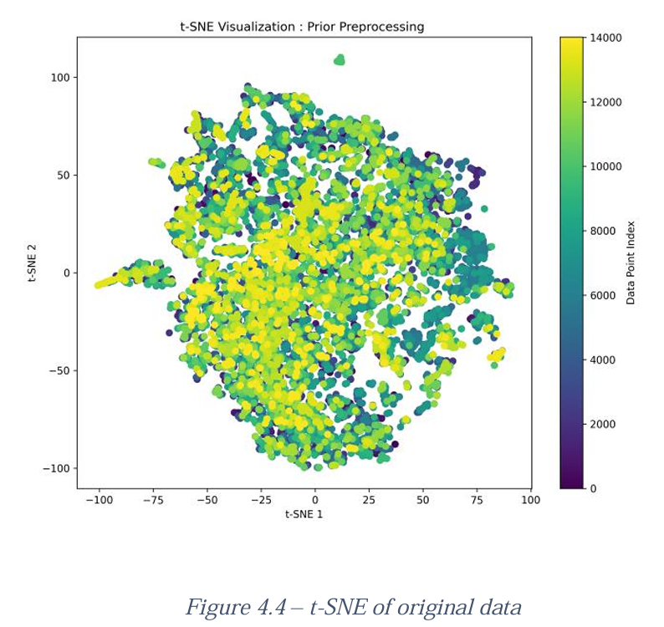
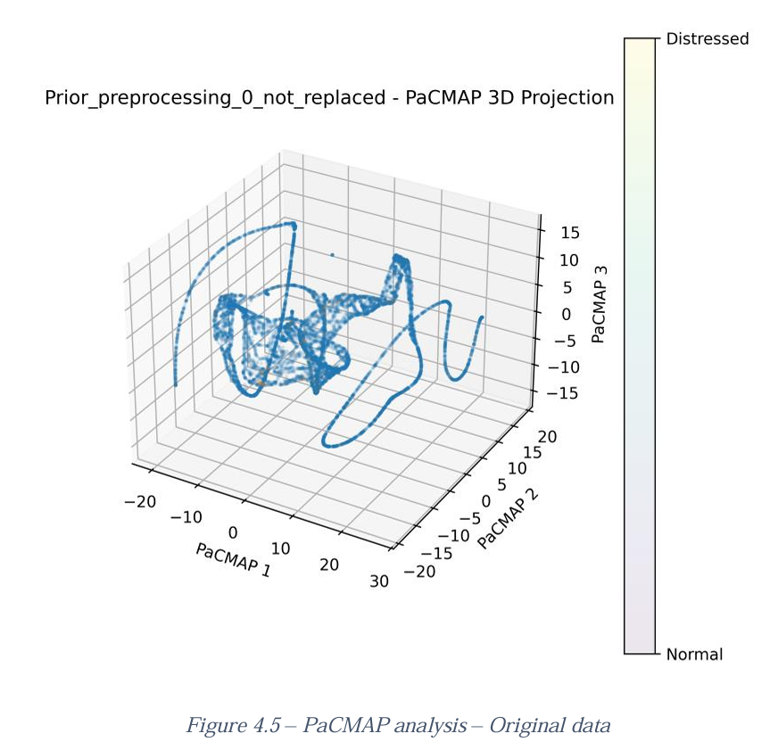
Analysis
9

Slide 12
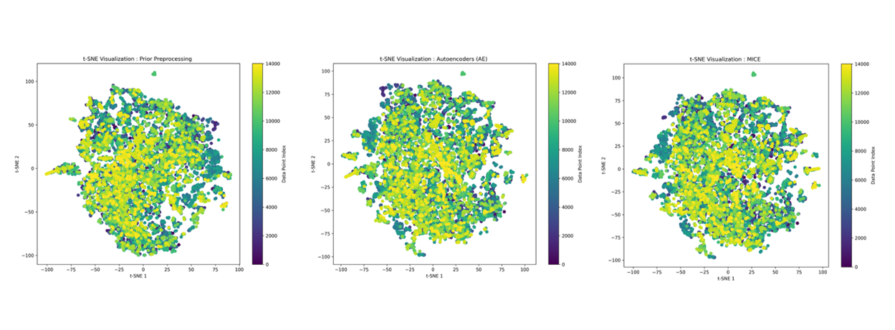
Results and discussion
Comparing imputation methods revealed minimal but significant differences in data structures, with MICE and Autoencoder methods each showing strengths in different scenarios.
10

Slide 13
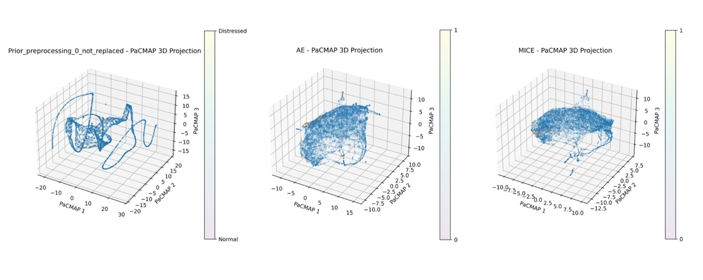
Results and discussion
The original data exhibits a complex pattern, while both Autoencoder and MICE reveal similar patterns. However, MICE notably shows more tightly packed clusters, indicating a more refined data structure.
11

Slide 14
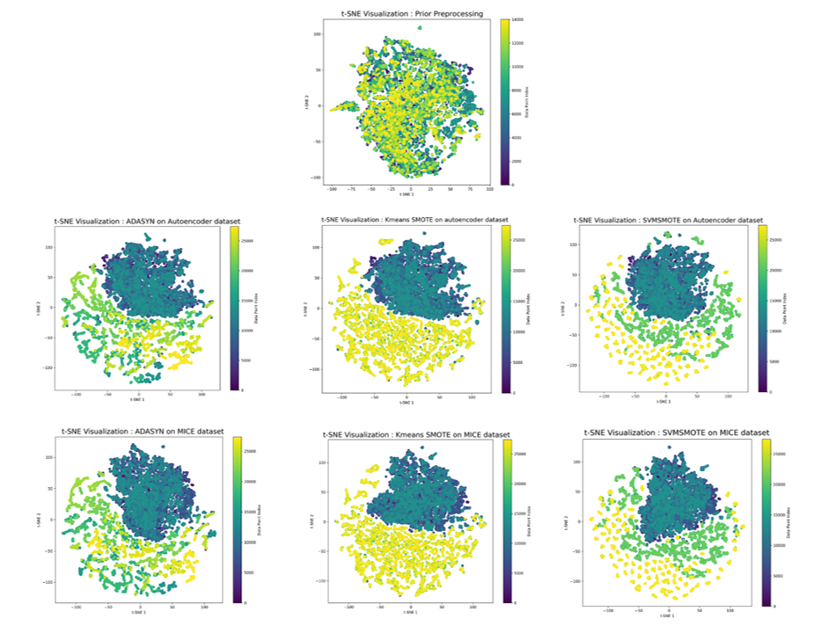
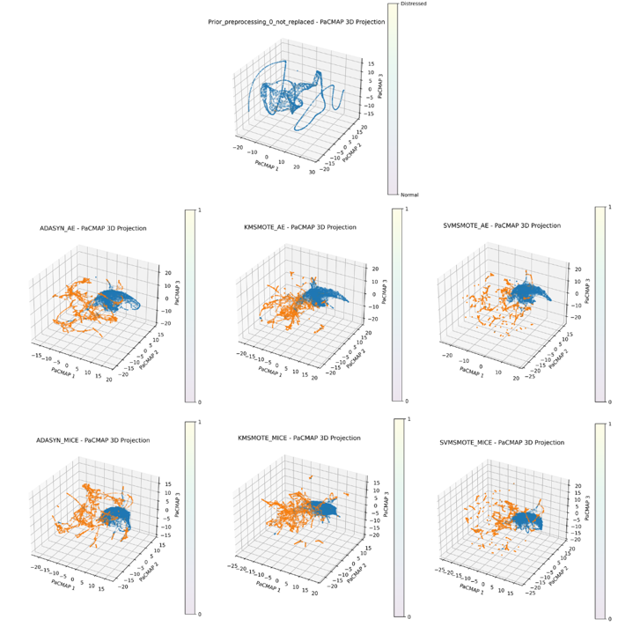
Results and discussion
12

Slide 15
Results and discussion
The model performances of imputed datasets, though having high accuracy (Avg: 0.88) have very low F1 (Avg: 0.42), G-mean (Avg: 0.54), Kappa metrics (Avg: 0.42)
The performances of the imbalance handled dataset have shown high and improved performances with F1 (Avg: 0.93), G-mean (Avg: 0.89) and kappa metrics (Avg: 0.83)
The results indicate that KMSMOTE, and SVMSMOTE methods have a slight edge when combined with MICE
XGBoost, Random forest, Gradient boosting models outperform other models in performance averaging accuracy of 0.993, 0.993, 0.992 respectively.
XGBoost scored the highest accuracy of 0.995 in the SVMSMOTE and AE dataset.
13

Slide 16
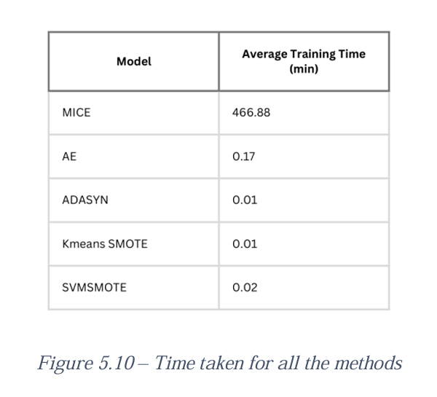
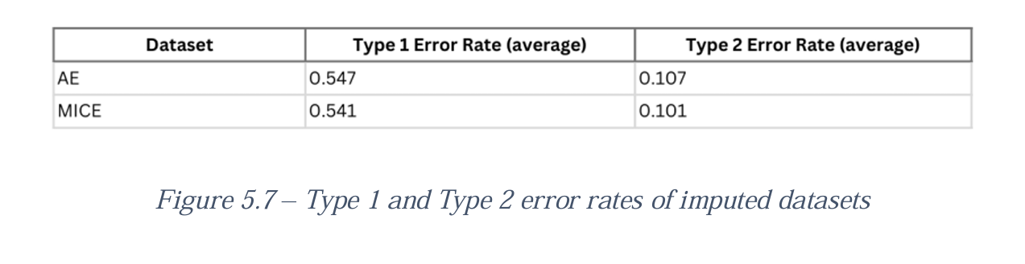
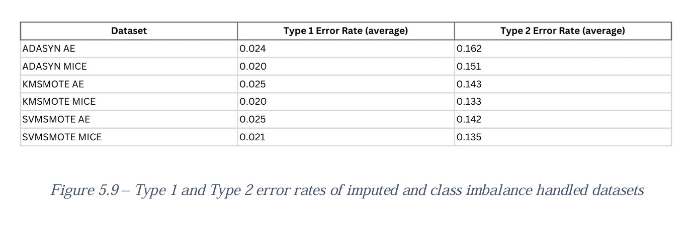
Results and discussion
MICE is highly computationally intensive
Class imbalance methods have decreased the Type 1 errors
Comparatively high type 2 errors found in the final evaluation
14

Slide 17
Conclusion
Important findings:
MICE using Random Forest Regressors, achieved slightly better performance than Autoencoders by capturing complex data relationships effectively
Autoencoders preserved the original structure of the data with less alterations
MICE is highly computational and time intensive
Cluster based sampling (KMSMOTE, SVMSMOTE) perform well in generating samples that improved the models’ performance
Class imbalance techniques have significantly reduced Type 1 errors.
Minimizing type 2 error is identified as a key challenge.
15

Slide 18
References (Literature review)
Balachander, T., Akhlaq, N., Bansal, R., Vasani, S.A., Singh, K. and Mannar, B.R., (2023) Financial Crisis Prediction using Feature Subset Selection with Quantum Deep Neural Network. In: Proceedings of the 2023 2nd International Conference on Electronics and Renewable Systems, ICEARS 2023. Institute of Electrical and Electronics Engineers Inc., pp.885–889.
Huang, Y., Wang, Z. and Jiang, C., (2024) Diagnosis with incomplete multi-view data: A variational deep financial distress prediction method. Technological Forecasting and Social Change, 201.
Kadkhoda, S.T. and Amiri, B., (2024) A Hybrid Network Analysis and Machine Learning Model for Enhanced Financial Distress Prediction. IEEE Access, 12, pp.52759–52777.
Matin, R., Hansen, C., Hansen, C. and Mølgaard, P., (2019) Predicting distresses using deep learning of text segments in annual reports. Expert Systems with Applications, 132, pp.199–208.
Papík, M. and Papíková, L., (2024) Automated Machine Learning in Bankruptcy Prediction of Manufacturing Companies. In: Procedia Computer Science. Elsevier B.V., pp.1428–1436.
16

Slide 19
Thank you
17

